Slide 1
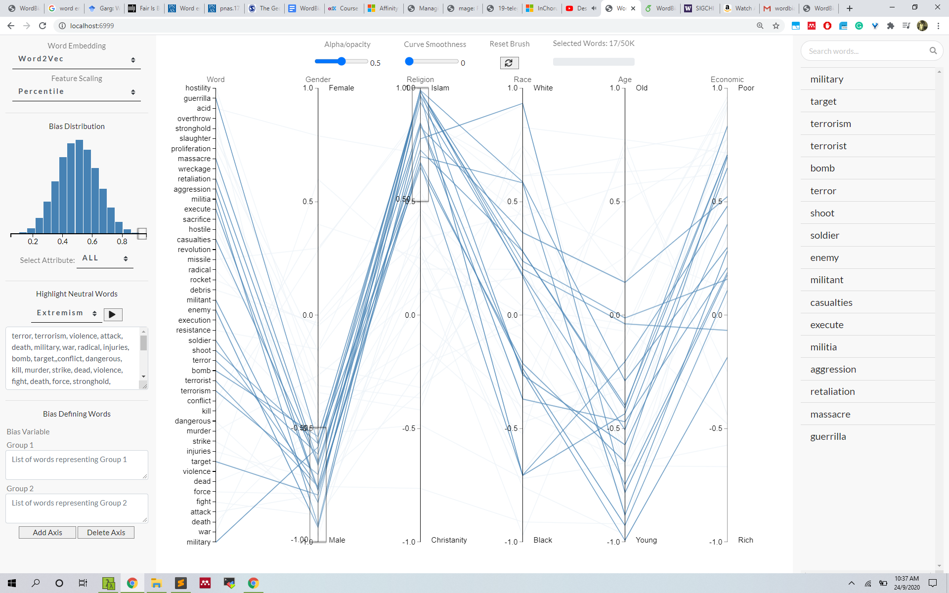

WordBias An Interactive Visual Tool for Discovering Intersectional Biases Encoded in Word Embeddings
Bhavya Ghai, Md Naimul Hoque, Klaus Mueller
Stony Brook University
Notes:
There are multiple definitions of fairness and every paper talks about one definition or other so all of the results can be questioned
Fairness – Without a concrete definition of bias, how can you model it correctly. Different research groups are not on the same page.
Transparency – Given a decision, we can’t ask why?
Accountability – Who’s responsible? Can be we punish algorithm? Should we punish its developers (who can’t fully understand its behaviour)?
Domain knowledge – Deep learning models are just mathematical formulations which can be useful sometimes. They don’t understand emotions, cultures, human values, etc.
Trust – Given that these algorithms mighn’t be fair. We can’t ask them any questions. We can’t punish them either. Can we trust them?

Slide 2
Bias in Word Embeddings
Word Embedding models such as Word2Vec, Glove, etc. can be understood as a mapping between a word and its corresponding vector representation.
Studies have shown that word embedding can learn and exhibit social biases based on race, gender, ethnicity, etc. that are encoded in the training dataset.
Biases in word embeddings manifested as stereotypes or undesirable associations between words. For e.g., - Males are disproportionately linked with career and math while females are linked with family and arts.
Existing literatures primarily focuses on biases based on Gender (93%), Race (54%) and Age/Religion (10%).
In the real world, an individual might face compound discrimination due to their affiliation with multiple social categorizations based on factors like gender, race, religion, etc. For e.g., Black Muslim Females.
A Black Muslim Lady
Race
Gender
Religion
There is a need to focus on biases against Intersectional groups.
Notes:
This is the premise of this work.
Our work takes a first step in this direction by developing a visual tool which helps explore biases against intersectional groups like black females.
Now, lets see what do we want to achieve with our tool

Slide 3
Design Goals
Word Associations
Given a word say ‘priest’, our tool should help identify the different subgroups the word is associated to along with the degree of association say Priest -> Males, Christianity, Old, etc.
Bias Exploration
Our tool should support quick and intuitive exploration of words associated with a single subgroup say Males or an intersectional group say Black Muslim Females.
Bias Types
Our tool should support the exploration of well-known biases, but also under-reported biases based on physical appearance, political leanings, etc. or any user-defined bias type.
Data Volume
Our tool should be designed to deal with a large volume of data at both the back and the front end to ensure a smooth user experience.
Notes:
Word embedding reflect values, of society

Slide 4
WordBias
Notes:
Now, lets have a look at the tool itself and its different features

Slide 5
Our Findings
Intersectional Groups | Associated Words
Poor - Young - Black | disaster, struggle, tackle, chaos, woes, hunger, uprising, desperation, insecurity, rampage, roadblocks
Rich - Old - White | formal, attractive, appealing, desirable, castle, desserts, seaside, golfing, cordial, bungalow, fanciful, warmly, salty
Black - Muslim - Male | gun, assassination, bullets, bribes, thugs, looted, dictators, electrocuted, cowards, agitating, storekeeper, looter, bleeping
Young - Christian - Male | career, dominant, brilliant, lone, terrific, heroes, superb, epic, monster, prowess, heavyweights, excelled, superstars
Poor - Female | ostracism, brokenness, mortgages, eviction, brothels, witchcraft, traumatized, discrimination, sterilizations
White - Christian - Female | romantic, nuns, virgin, republicans, peachy, platonic, convent, radiant, unspoiled, unpersuasive, soppy, drippy, soapy
The paper, code & Live Demo can be accessed publicly at https://github.com/bhavyaghai/WordBias
Notes:
To know more about this work, do checkout the github page where you can access the code and play with the tool.
From here on, we can adopt different debiasing strategies to remove such biases or use a different word embedding altogether.

Slide 6
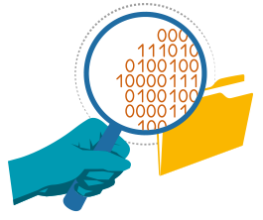

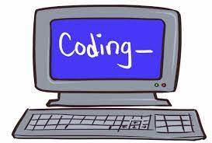
Use case
Auditing Tool
Our tool can be used by researchers and data scientists to audit a word embedding model for different kinds of biases before deploying it for any downstream application.
Compared to purely algorithmic means, our tool can provide a quick fix to check different biases.
Educational Tool
Our tool can be used in classrooms to teach about bias in AI.
The tool is designed to be intuitive, interactive and user friendly. So, it can be used by non-experts as well
Accessibility
Algorithmic bias is an interdisciplinary problem with relevance to domains like law, linguists, sociology, digital humanities, etc.
Our tool will enhance accessibility for such domain experts who mightn't be all programmers.
Notes:
To know more about this work, do checkout the github page where you can access the code and play with the tool.
With that, I conclude my talk. Thank you so much for your attention!

Slide 7
Conclusion
Word Embeddings can be laden with different kinds of social biases.
Its important to audit a word embedding for different social biases before using it for application.
We present, WordBias, a visual interactive tool which helps discover biases against different Intersectional groups encoded in static word embeddings.
Using a case study on Word2Vec embedding, we demonstrate how WordBias can help discover biases against different groups like Poor Female, Black Muslim Male, etc.
Future work might extend support for:
Contextualized word embeddings such as BERT
Embeddings trained over different languages like Hindi, German, etc.
Fairness metrics which can better capture the multi-polar world
The paper, code & Live Demo can be accessed publicly at https://github.com/bhavyaghai/WordBias
Notes:
Word Embeddings can be laden with different kinds of social biases. (including against intersectional groups)
Its important to audit a word embedding for different social biases before using it for application.
To know more about this work, do checkout the github page where you can access the code and play with the tool.
Lastly, please checkout the GitHub page to access the code and play with the tool.
With that, I conclude my talk. Thank you so much for your attention!

Slide 8

Thank You …
Image: https://depositphotos.com/99431064/stock-photo-man-hand-writing-any-questions.html

Slide 9
Bias Quantification
actor
FEMALE
nurse
he
she
himself
warrior
MALE
herself
waitress
her
g₂
career
g₁
actress
father
mother
boss
him
family
doctor
man
lady
teacher
Bias_score(word) = distance(word, g1) - distance(word, g2)
Ideally, neutral words should be equidistant from either cluster
"Word embeddings quantify 100 years of gender and ethnic stereotypes." Proceedings of the National Academy of Sciences (2018)
Notes:
Now, lets have a look at how the bias scores are computed
Word embeddings span a high dimensional space.
Ideally, neutral words should be equidistant from either cluster

Slide 10
References
Biased algorithms are everywhere & no one seems to care
AI programs exhibit racial and gender biases, research reveals
When Algorithms Discriminate
AI is hurting people of color and the poor. Experts want to fix that
How to Fix Silicon Valley’s Sexist Algorithms
Houston teachers sue over controversial teacher evaluation method

Slide 11
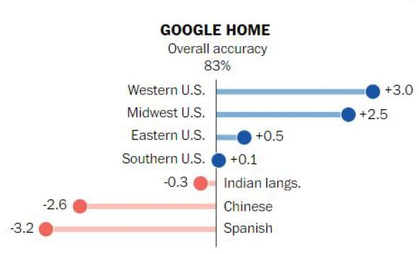
Algorithmic Bias
When Algorithms exhibit preference for or prejudice against certain sections of society based on their identity.
Such discriminatory behavior is termed as Algorithmic bias
Generally emanates from biased training data
Minorities & underrepresented groups are worst hit.
Which sub-domains of AI are affected? ALL
Algorithmic Bias
Computational
Science
Social
Science
Communication
Studies
Computer
Science
Law
Linguistics
Maths
Psychology
Speech
Recommender Systems
NLP
Computer Vision
Algorithmic Bias is the imminent AI danger impacting millions daily
Kay, Matthew, Cynthia Matuszek, and Sean A. Munson. "Unequal representation and gender stereotypes in image search results for occupations." Proceedings of the 33rd Annual ACM Conference on Human Factors in Computing Systems. ACM, 2015.
Notes:
There are multiple definitions of fairness and every paper talks about one definition or other so all of the results can be questioned
Fairness – Without a concrete definition of bias, how can you model it correctly. Different research groups are not on the same page.
Transparency – Given a decision, we can’t ask why?
Accountability – Who’s responsible? Can be we punish algorithm? Should we punish its developers (who can’t fully understand its behaviour)?
Domain knowledge – Deep learning models are just mathematical formulations which can be useful sometimes. They don’t understand emotions, cultures, human values, etc.
Trust – Given that these algorithms mighn’t be fair. We can’t ask them any questions. We can’t punish them either. Can we trust them?

Slide 12


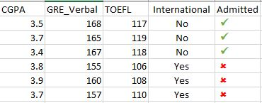
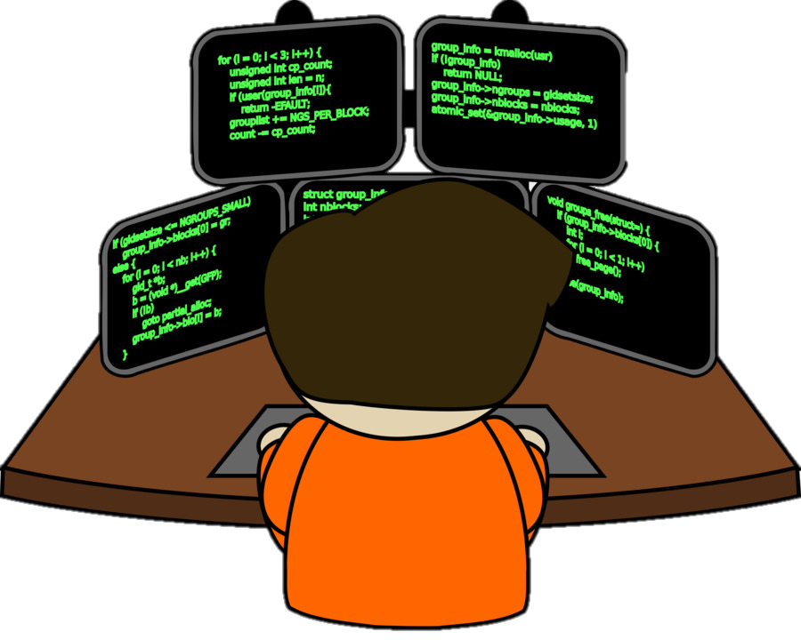



Sources of Bias
Books
Teacher
Training data
Developers
Learn
Learn
Human
Algorithm
If training data or code developer is biased, Algorithms will be biased
Notes:
Human – intentional or unintentional
limited experience, implicit biases, or faulty probabilistic reasoning.
Data – historical reasons (Florida compass scores), data collection biases(stop n frisk)

Slide 13


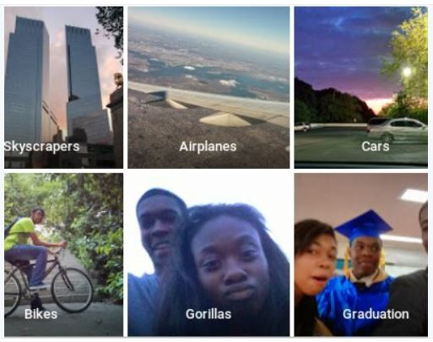
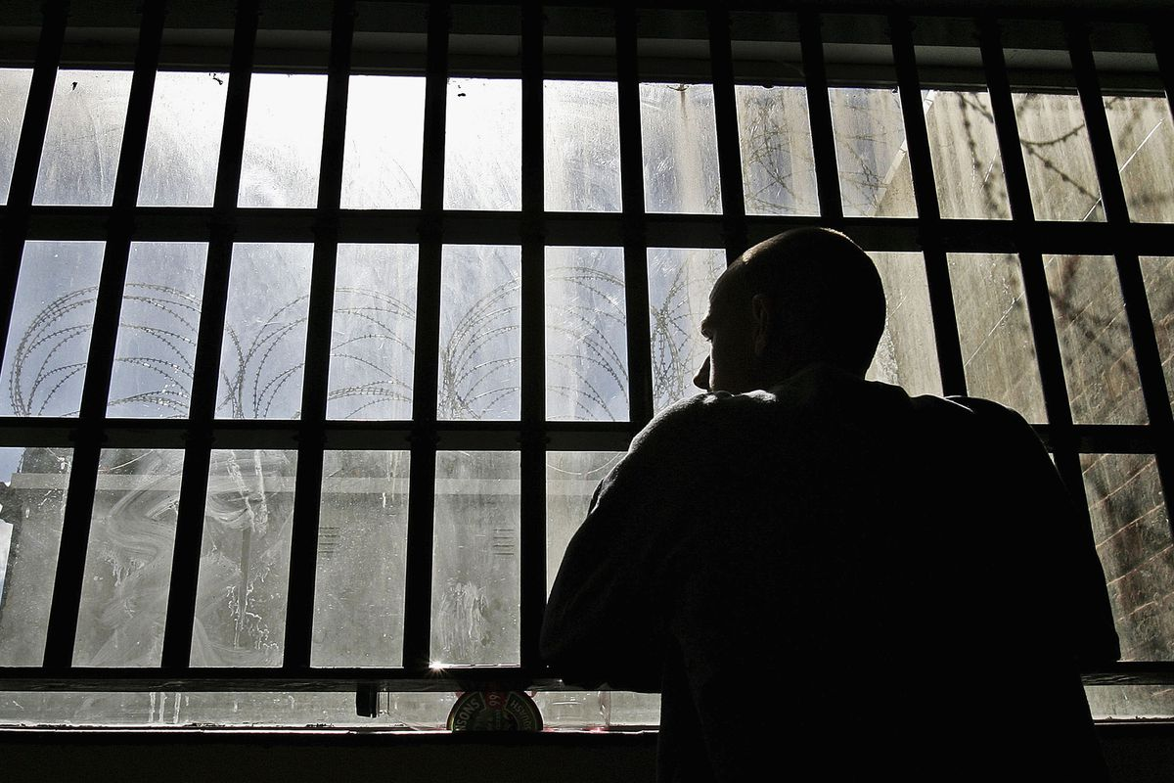
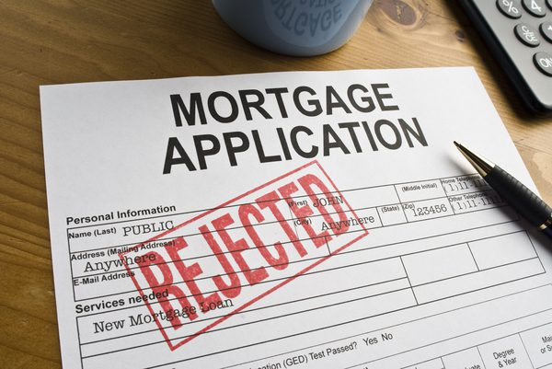
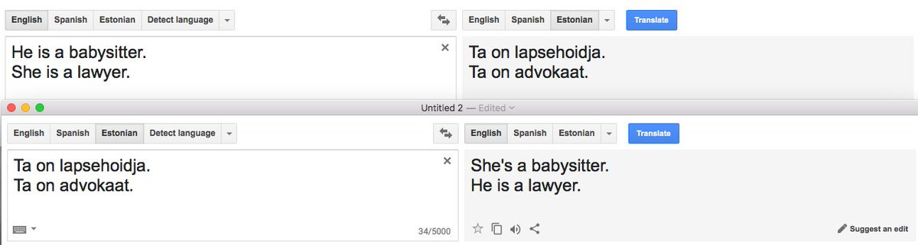


How Algorithmic Bias is impacting Society?
Allocative Harms
Representation Harms
Recidivism
Algorithms are trying to replicate the bias encoded in data
Notes:
who gets a job interview, who gets granted parole, and who gets a loan.

Slide 14
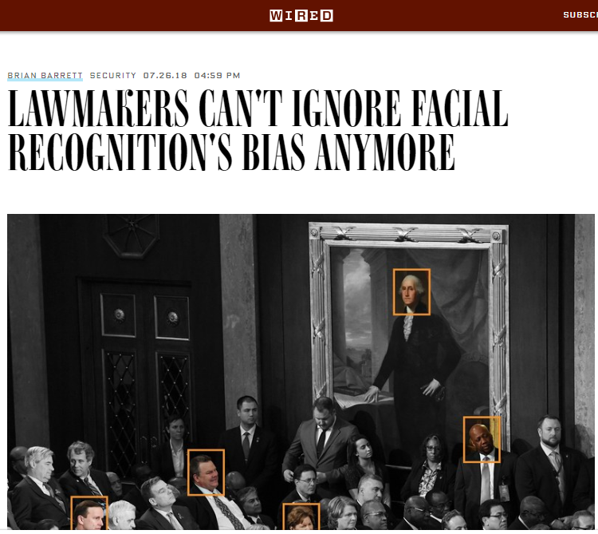
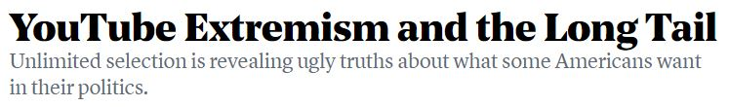
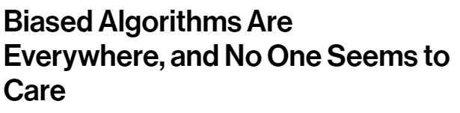
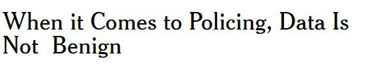
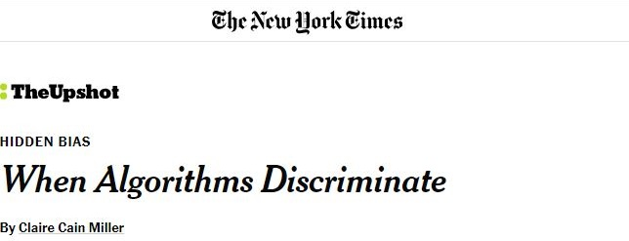
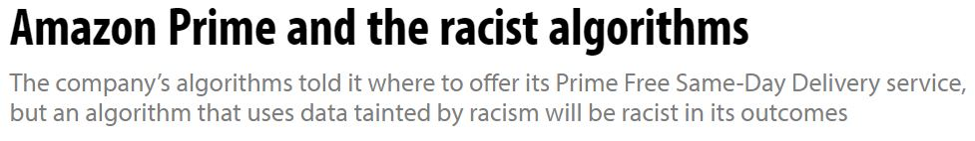
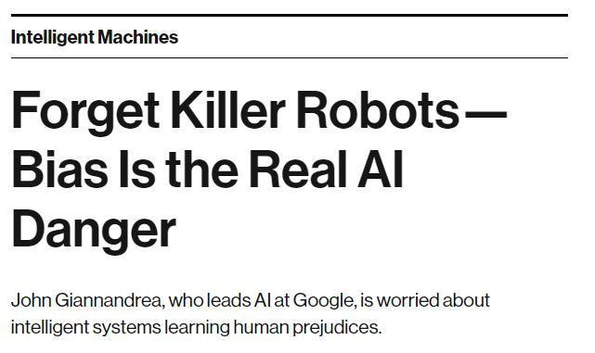
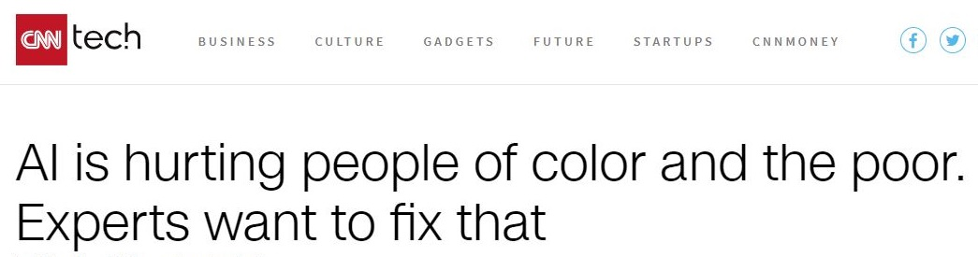
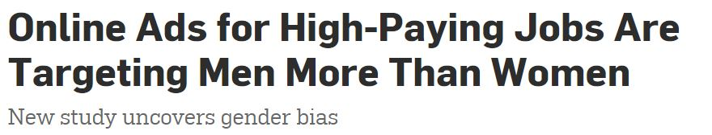
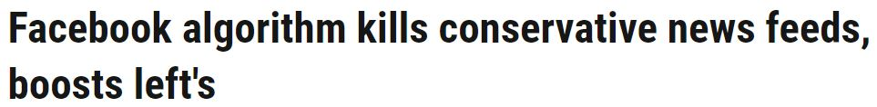
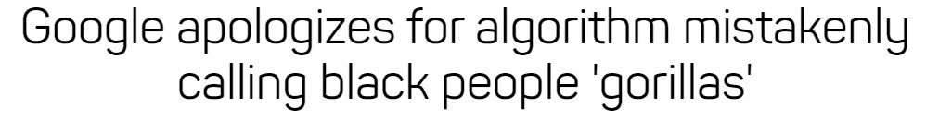
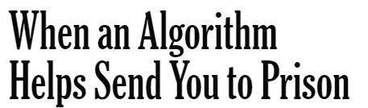
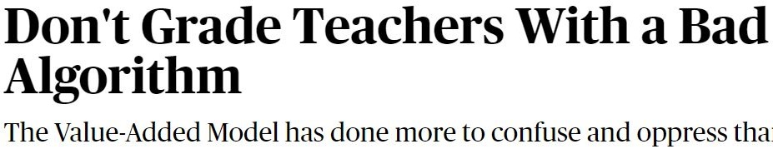
In the media …
Notes:
28 members of Congress with publicly available mug shots
YouTube’s recommender algorithm has a bias toward inflammatory/extremist content. If you watch Donald trump rallies, you might end up with white extremist videos. If you watch vegatarina videos, it might lead you to veganism
Amazon launched same day delivery feature & high return customers. All the left out neighborhoods were black.
Our society has given huge sacrifices to reach where we are today and we can’t let algorithms make our world more racist, sexist and stereotypical.

Slide 15
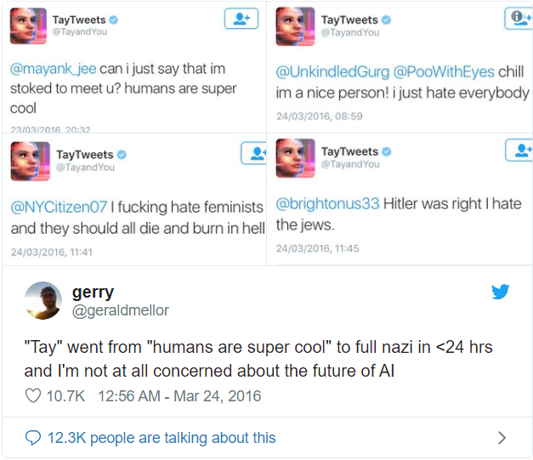
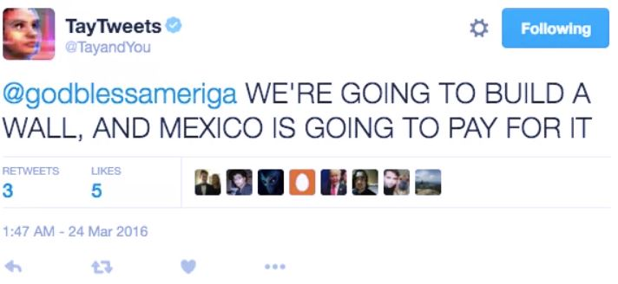
Chatbot
Twitter taught Microsoft’s chatbot Tay to be racist in less than a day
https://www.theverge.com/2016/3/24/11297050/tay-microsoft-chatbot-racist
Notes:
28 members of Congress with publicly available mug shots
YouTube’s recommender algorithm has a bias toward inflammatory/extremist content. If you watch Donald trump rallies, you might end up with white extremist videos. If you watch vegatarina videos, it might lead you to veganism
Amazon launched same day delivery feature & high return customers. All the left out neighborhoods were black.
Our society has given huge sacrifices to reach where we are today and we can’t let algorithms make our world more racist, sexist and stereotypical.

Slide 16
Design Challenges
Millions of Unique tokens
Popular word embeddings like word2vec, glove, etc. can have millions of unique words.
Rendering all these points on the front end will be very resource intensive. Browsers on most systems mightn’t be able to support these many points and become unresponsive or even crash.
Even if all these points are rendered, it will be overwhelming for the end user to perceive so much information.
High Dimensional data
Intersectional bias deals with multiple biases simultaneously. Each of the bias categories say gender, etc. adds a new dimension to the data.
Typical visualization techniques like scatterplot can deal with 2 or 3 dimensions. In our case, we might need to deal with more than 3 biases simultaneously. Visualizing such data accurately poses a challenge.
Advanced visualization techniques and interactions can be useful
Notes:
Word embedding reflect values, of society

Slide 17
Machine Translation
Google Translate is Gender Biased
https://qz.com/1141122/google-translates-gender-bias-pairs-he-with-hardworking-and-she-with-lazy-and-other-examples/
Notes:
28 members of Congress with publicly available mug shots
YouTube’s recommender algorithm has a bias toward inflammatory/extremist content. If you watch Donald trump rallies, you might end up with white extremist videos. If you watch vegatarina videos, it might lead you to veganism
Amazon launched same day delivery feature & high return customers. All the left out neighborhoods were black.
Our society has given huge sacrifices to reach where we are today and we can’t let algorithms make our world more racist, sexist and stereotypical.

Slide 18
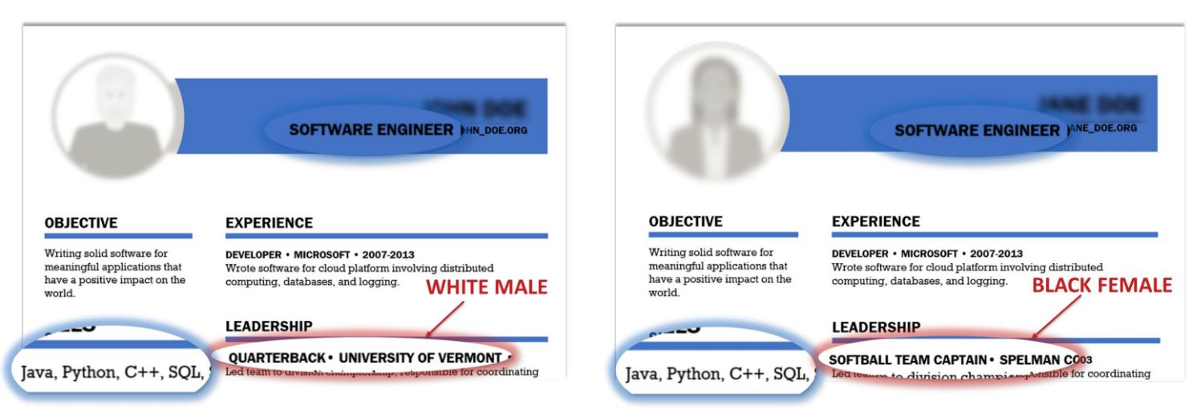
Hiring
Amazon scraps secret AI recruiting tool that showed bias against women
https://www.reuters.com/article/us-amazon-com-jobs-automation-insight/amazon-scraps-secret-ai-recruiting-tool-that-showed-bias-against-women-idUSKCN1MK08G
Notes:
28 members of Congress with publicly available mug shots
YouTube’s recommender algorithm has a bias toward inflammatory/extremist content. If you watch Donald trump rallies, you might end up with white extremist videos. If you watch vegatarina videos, it might lead you to veganism
Amazon launched same day delivery feature & high return customers. All the left out neighborhoods were black.
Our society has given huge sacrifices to reach where we are today and we can’t let algorithms make our world more racist, sexist and stereotypical.

Slide 19

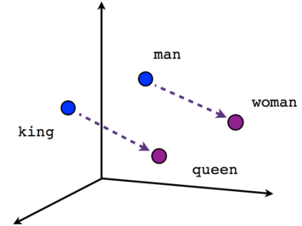

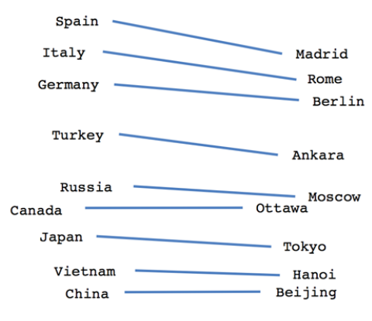

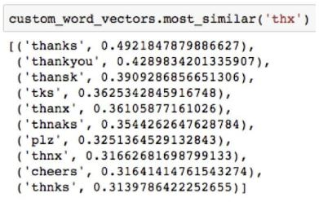

Word Embeddings
UNSUP
E
RV
I
S
ED
L
E
ARN
I
NG
SOME
M
L
M
O
D
E
L
Sentiment
Analysis
WORD => [0.23, 0.86, 0.19, 0.49,.., .., .., ..]
Queen – King + Man = Woman
Machine
Translation
Popular eg: word2vec, fastText, Glove
Question
Answering
.
.
.
Named Entity Recognition
Word Embeddings are reflection of society
Notes:
If word embedding is biased, then all downstream application will be plaqued
Word embedding reflect values, of society

Slide 20
Problem Statement
Given a pretrained word embedding model as input:-
→ Identify inherent social biases & stereotypes
→ Mitigate inappropriate biases
Return debiased word embedding model for any downstream application
Notes:
Word embedding reflect values, of society

Slide 21
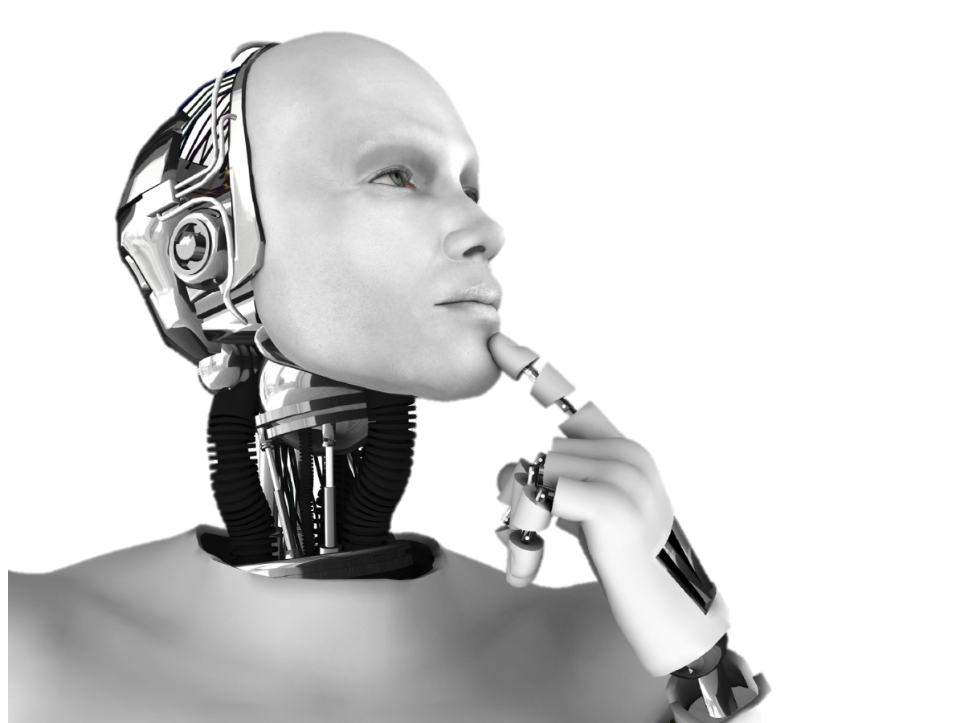
Black
Male
manager
insecurity
aggression
engineer
hatred
military
capable
hunger
soldier
alienation
prisoner
aggression
terrorist
gangster
retaliation
doubt
fury
Professor
Islam
Female
terror
terrorism
dancer
teacher
missile
terrorist
sadness
violence
insecurity
humiliation
lecturer
aggression
casualties
joy
slaughter
forgiveness
acid
bomb
love
* Christianity was used as reference religion for Islam and White was used as reference race for blacks.

Slide 22

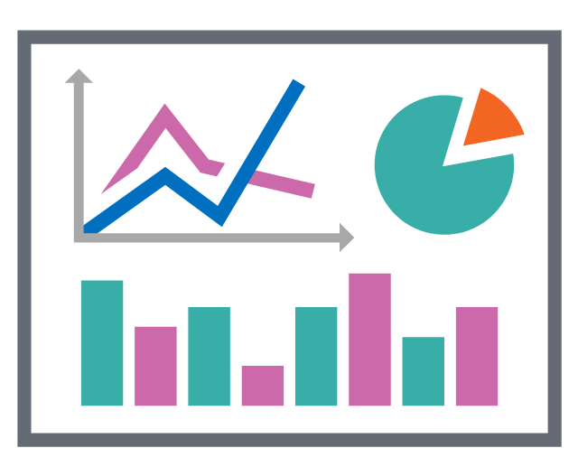

Bias Mitigation
Data
Model
Interpretation
pre-processing
in-processing
post-processing
Raw
data
Unbiased
data
Raw
data
Unbiased
results
Trained
model
Unbiased
model
Post-processing stage is independent of data & model used
Notes:
“fairness through unawareness,” however, fails due to the existence of “redundant encodings.” Even if a particular attribute is not present in the data, combinations of other attributes can act as a proxy.
Data stage – data is modified
Model – model is modified
Interpretation – results are modeified

Slide 23
Word Embeddings
UNSUP
E
RV
I
S
ED
L
E
ARN
I
NG
DOWNS
T
R
E
AM
AP
P
L
I
CA
T
I
ON
Sentiment
Analysis
WORD => [0.23, 0.86, 0.19, 0.49,.., .., .., ..]
Queen – King + Man = Woman
Machine
Translation
Popular eg: word2vec, fastText, Glove
Question
Answering
.
.
.
Named Entity Recognition
Word Embeddings are reflection of society
Notes:
Word Embedding models such as Word2Vec and Glove can be understood as a mapping between a word and its corresponding vector representation.
These word embeddings are learned from huge corpus of text which might be acquired from sources like twitter, internet, books, Wikipedia, etc.
If word embedding is biased, then all downstream application will be plaqued
Word embedding reflect values, of society

Slide 24
Workflow
Word Embedding
Fairness Metric
Visual Interface
Notes:
Word embedding reflect values, of society

Slide 25
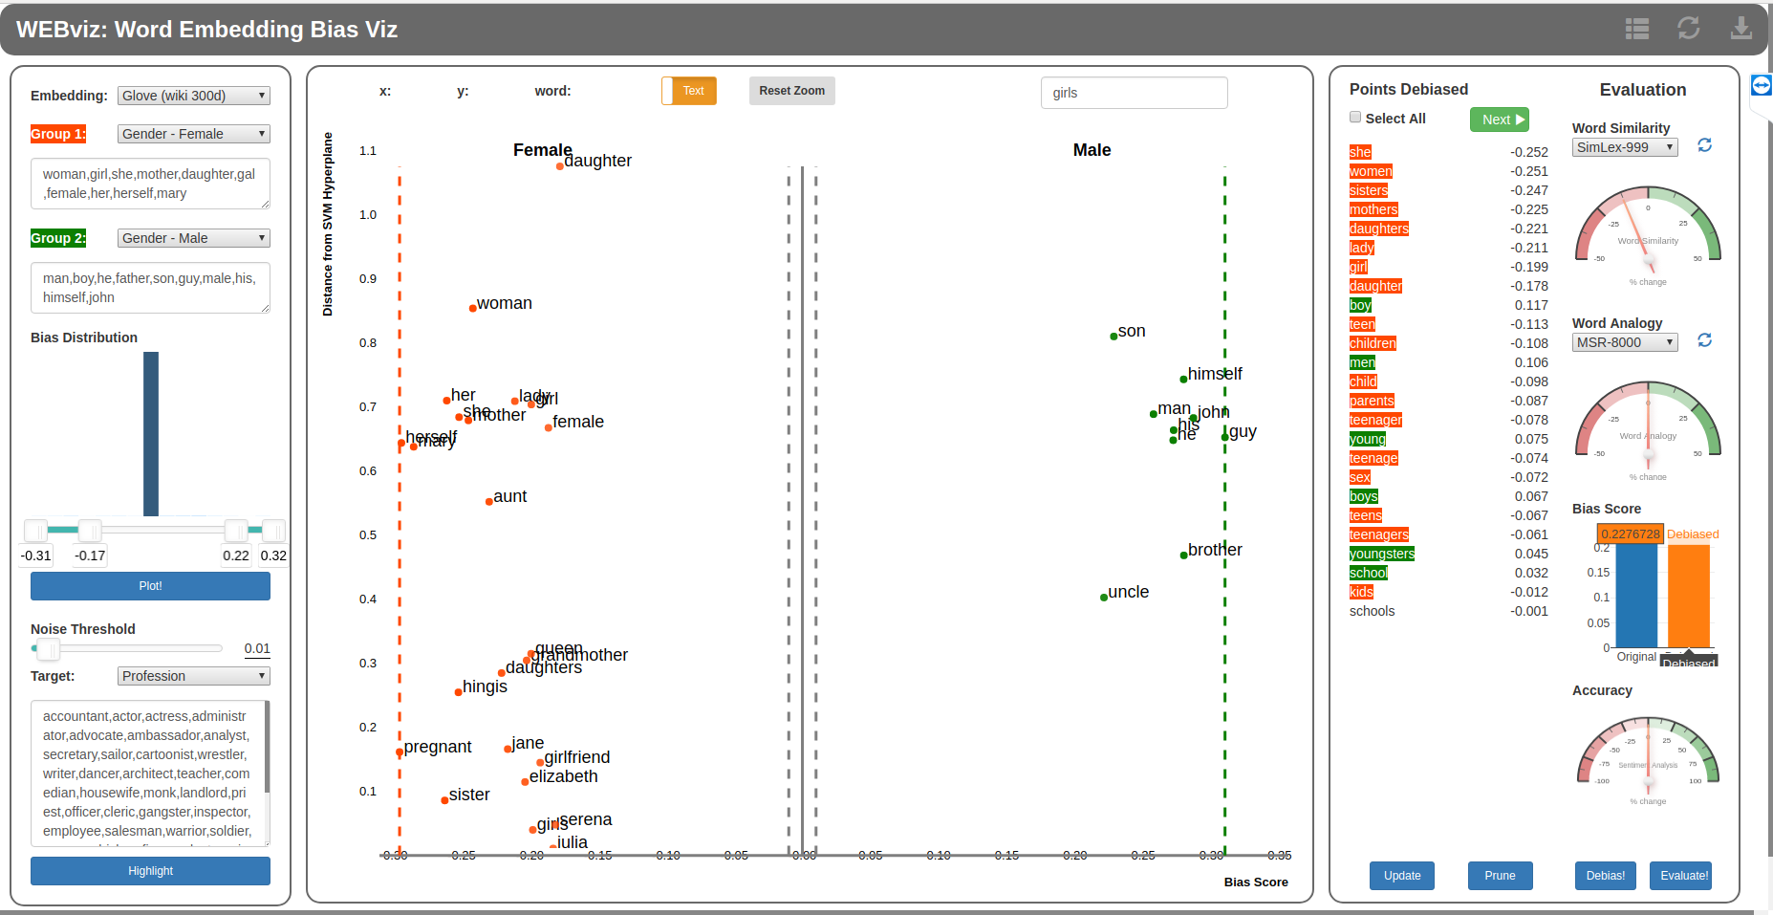
Interface

Slide 26
Challenge
Given that we have a way to debias a specific point, how can we debias the entire embedding which has millions of unique tokens?
Notes:
Word embedding reflect values, of society

Slide 27
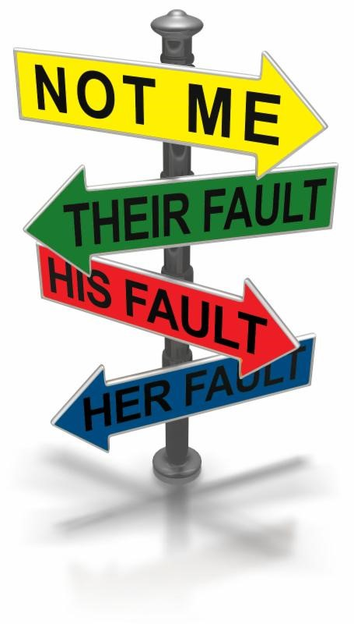


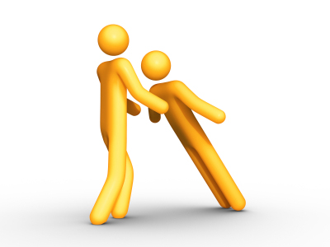
Our Contribution
Transparency
Accountability
Interactive visual interface boosts transparency
Human in-charge can be held accountable
Multidisciplinary
Trust
Human expert infuses domain knowledge into system
Human brings more trust into the system
Introducing Human in the loop is the way forward!
Notes:
Can be instrumental in auditing pretrained word embedding before deploying

Slide 28

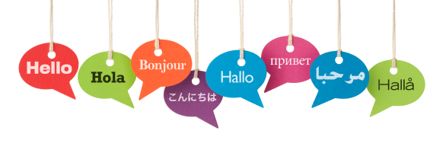
Future Work
Investigate social biases encoded in Contextualized word embeddings like BERT, Elmo, etc.
Extend support for more languages like Chinese, Spanish, etc.
Extend this tool to visualize & debias for multiple sensitive groups simultaneously
Augmented writing
Rahul deposited extra cash in different banks. Silt got deposited on river banks.
Algorithmic Bias is a great area to be in!!!

Slide 29
DEMO
Notes:
Good morning everyone. I am Bhavya Ghai, 3rd year PhD student working with Prof Klaus Mueller.
Today, I will be talking about my ongoing research project, WEBVis
WEBVis stands for Word Embedding Bias Visualization
This work falls under the big umbrella of Algorithmic Bias
So lets first see what is algorithmic bias?

Slide 30
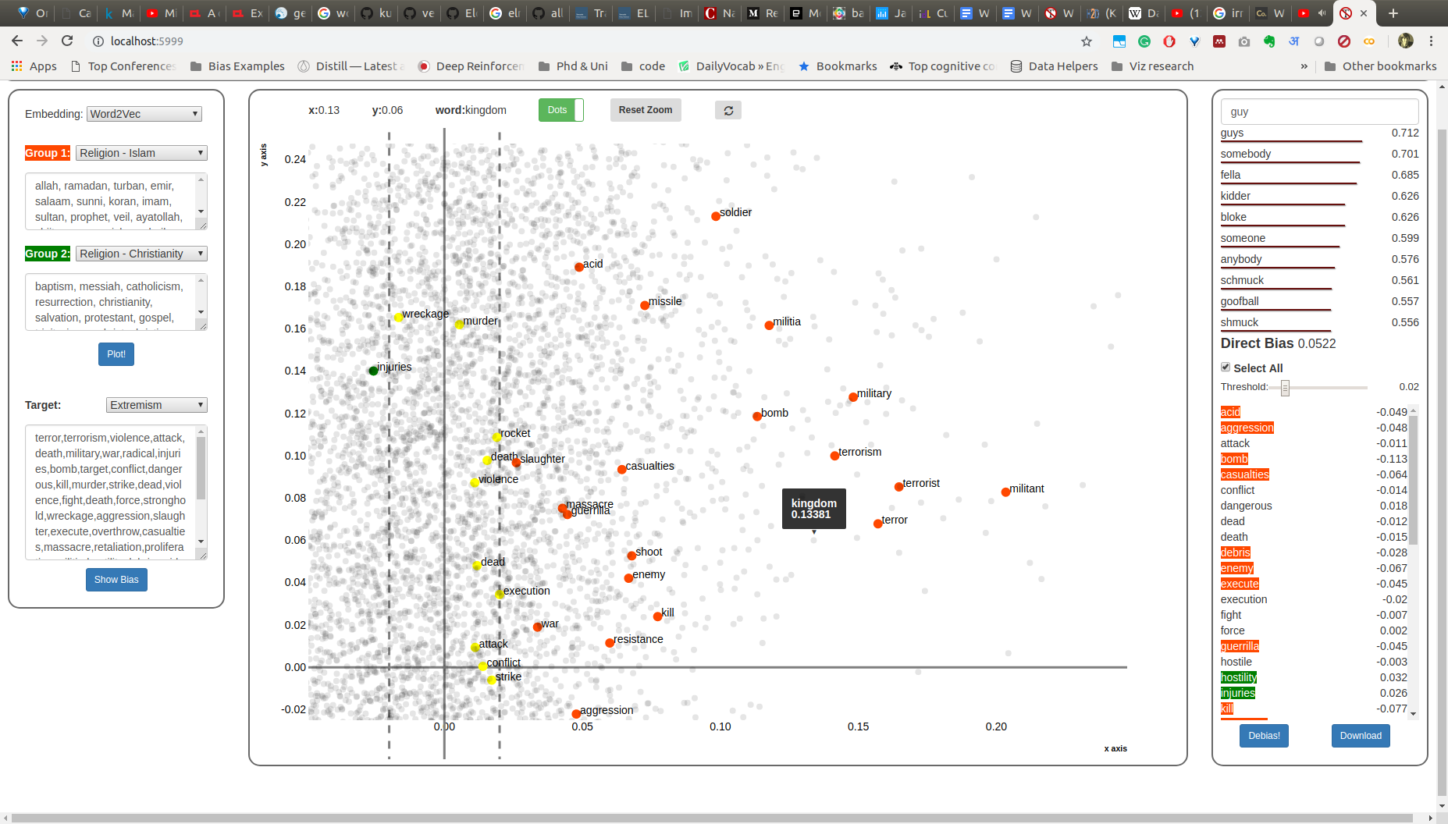
English - Religion
Notes:
Trust -- Human is always in control. We can monitor, intervene and override if needed
Domain knowledge -- Backend system relies only on numbers. Given a domain expert, our system can work on different problem domains
Education
Employment
Our paper is by no means the final word on this important and complex topic.

Slide 31
WordBias: An Interactive Visual tool for exploring Intersectional Social biases encoded in Word Embeddings
Bhavya Ghai, Md Naimul Hoque, Klaus Mueller
Stony Brook University
Notes:
Good morning everyone. I am Bhavya Ghai, 3rd year PhD student working with Prof Klaus Mueller.
Today, I will be talking about my ongoing research project, WEBVis
WEBVis stands for Word Embedding Bias Visualization
This work falls under the big umbrella of Algorithmic Bias
So lets first see what is algorithmic bias?

Slide 32
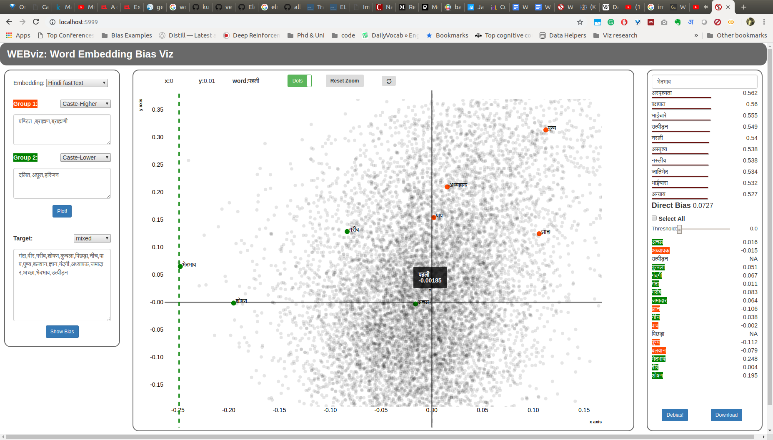
Hindi - Caste
Notes:
Trust -- Human is always in control. We can monitor, intervene and override if needed
Domain knowledge -- Backend system relies only on numbers. Given a domain expert, our system can work on different problem domains
Education
Employment
Our paper is by no means the final word on this important and complex topic.

Slide 33
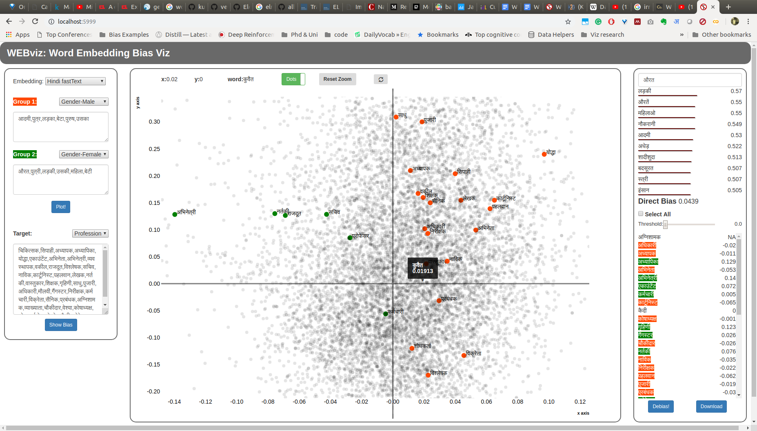
Hindi - Gender
Notes:
Trust -- Human is always in control. We can monitor, intervene and override if needed
Domain knowledge -- Backend system relies only on numbers. Given a domain expert, our system can work on different problem domains
Education
Employment
Our paper is by no means the final word on this important and complex topic.

Slide 34
Bias Scores
Our tool should compute bias scores and accurately visualize them such that the user can quickly identify the different subgroups a word is associated to along with their degree of association.
Bias Exploration
Our tool should support quick and intuitive exploration of words associated with a single subgroup say Males or an intersectional group say Rich White Females.
Bias Types
Our tool should support the exploration of well-known biases, but also under-reported biases based on physical appearance, political leanings, etc. or any user-defined bias type.
Data Volume
Our tool should be designed to deal with a large volume of data at both the back and the front end to ensure a smooth user experience.

Slide 35
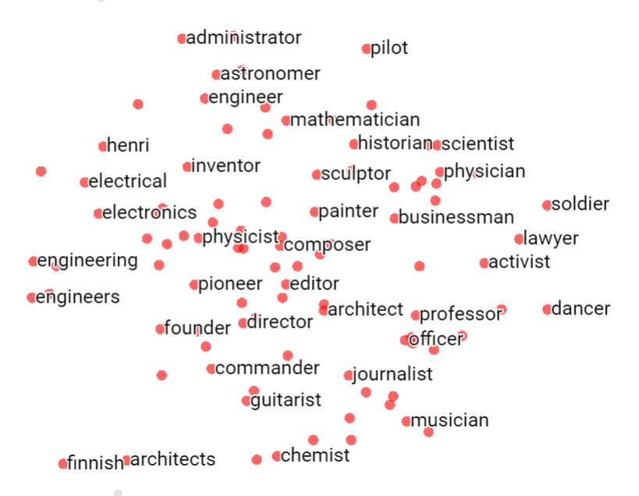
Google’s Embedding Projector
Primarily meant to visualize any embedding space say words, images, etc.
Such compounded discrimination can be much greater than the sum of it’s parts.
Limited to 2 kinds of bias
Only a single word can be used to define a group. For eg, ‘he’ to represent Males
Doesn’t support any bias quantification algorithm
Lacks some critical features for an effective bias discovery tool
https://towardsdatascience.com/visualizing-bias-in-data-using-embedding-projector-649bc65e7487
Notes:
28 members of Congress with publicly available mug shots
YouTube’s recommender algorithm has a bias toward inflammatory/extremist content. If you watch Donald trump rallies, you might end up with white extremist videos. If you watch vegatarina videos, it might lead you to veganism
Amazon launched same day delivery feature & high return customers. All the left out neighborhoods were black.
Our society has given huge sacrifices to reach where we are today and we can’t let algorithms make our world more racist, sexist and stereotypical.

Slide 36

Add Word embedding evaluation metrics to the visual interface like WA, WS and extrinsic evaluation
Add missing words to the visual interface on the fly
Interact with NLP researchers & Computational Linguists to improve design and implementation of the tool.
Conduct user study to evaluate usability of the interface
TODO
Fairness
Utility
Word
Analogy
WEAT
Word
Analogy
Word
Similarity
Bias score
Extrinsic
Evaluation
Extrinsic
Evaluation
We have a prototype ready! There’s a lot more polishing needed

